Slide 1

Oral Presentations
ENGG1000 2018
Ms Pam Mort, The Learning Centre & Dr Alex von Brasch, School EE et al...
This is a publicly available resource for staff and students at UNSW. UNSW students may download a single copy for individual study purposes. No parts of this guide may be reproduced without permission from the author. If educators or institutions not part of UNSW would like to use the resource in their own courses, written permission is required. Please contact Pam Mort (p.mort@unsw.edu.au ) for permission and comments.

Slide 2
Your task… Your pitch!
Explain your technical solution in a coherent and succinct manner
Justify why your chosen design will win the competition
Convince your client that you have a viable plan to present a functional prototype at final testing
Present as a group
Do not go over time (20 Minutes – includes Q&A)
No more than 8 PowerPoint slides

Slide 3





6 Steps
For
Preparing an
Oral
Presentation
Rehearse
Visual Aids
Organise Ideas
Research
Audience
Purpose

Slide 4
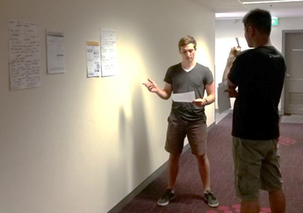
Preparing a script
100 to 120 words per minute – speaking pace
Spoken academic style
Read out loud – adjust so it feels natural for you to say
Prepare a rehearsal template
Rehearse with your team

Slide 5
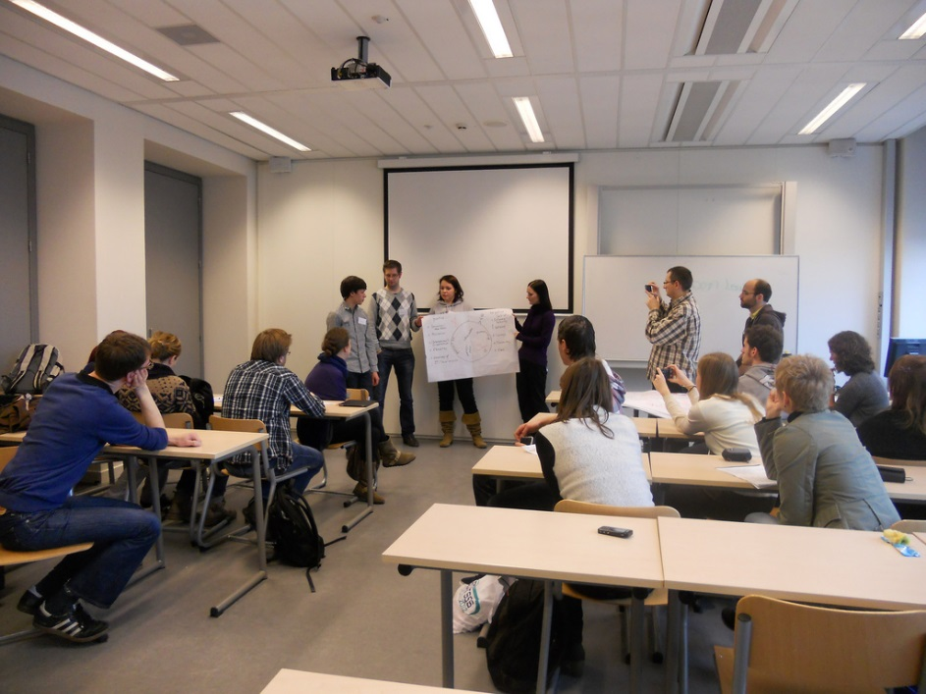
Good group presentations
Consistent & coherent slide show –have at least TWO final editors
Smooth handovers between speakers
Prepare possible questions in advance
Rehearse at least twice together
Check timing and logic
Practise answering questions
Make changes

Slide 6
PowerPoint Pitfalls
• Ignoring the audience
• Turning all the lights off
• Too many slides
• Reading slides aloud
• Too much text/bullet points on the slide
• Too many animations/decoration
• Extremely large headers for each slide
• Imported images unreadable- pale or small
Unreadable colour combinations
Expecting your slides to give the presentation

Slide 7
Who was in the course? What did they do?
Three original slides …
What is working well and why ?
mainly post graduate international students
broad range of disciplines
key focus: assess how online workshops supplement face to face learning
summer semester 2011/2
content: quoting, paraphrasing, summarizing
Session Overviews
Written tasks (written response from tutor)
Forum participation
Quiz tasks (automated feedback and answers)
TLC online resources
What is not working so well / as expected ..and why ?
Participation rate:
11 students active
view rate of tasks greater than submission rate
attrition rate 40-50% on average
4 students completed course overall
one student completed final task (resubmit of original submission)
Evidence of improvement in student academic literacy
Small sample size
Time to improve
Script or slides ?

Slide 8
Revised single slide
Summary- Findings
Participation
19 students enrolled 40-50% attrition over 10 weeks | 11 students ‘active’ Forum & quizzes | 4 completed course 1 submitted final writing task** 2 completed exit survey
Course content
Academic writing quoting, paraphrasing , summarising | Individual needs not always met by generic material | Academic input needed for Discipline Specific content
Quizzes rated ‘extremely informative ‘- want more | Clarification of writing task needed | Writing tasks rated as ‘challenging’
Tutor support
Want more tutor interaction | Want more time to complete tasks | Want fast feedback
Evidence of improved academic literacy?
Small sample size Tasks not compulsory | automated quizzes - achieved high grades-may be due to multiple attempts. | ** student’s writing (entry vs exit) dramatic improvement in structure & cohesion.

Slide 9
Original slide
Main Objective: Students edit own work with online self access tasks & minimal tutor guidance (no f2f) in flexible delivery mode.
Model Description:
Blah blah blah blah blah blah blah blah ………….

Slide 10
Revised slide
Practising Academic Literacy
Generic Self-paced Model
Student self enrols
Chooses module/s
Tutor feedback
Module 1
Module 2
Submit sample writing - conditional
Module 3
Module n…
Completes module

Slide 11
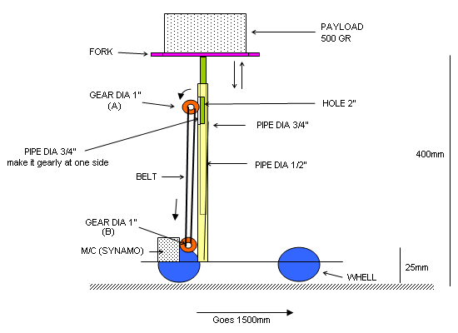
Prototype - side view

Slide 12
Font size
Times New Roman 18
Times New Roman 20
Times New Roman 24
Times New Roman 28
Times New Roman 32
Times New Roman 36
Times New Roman 80

Slide 13

Which is easier to read?
Red text on blue background
Yellow text on orange background
Blue text on white background
Blue text on green background
White text on black background

Slide 14
The Introduction
Greet the audience
Introduce Self
Introduce Topic & scope
Explain your purpose/position
Give an outline
Make transition to body
“Good morning...
I’m Julie and this is Fred, .. “
“Today we’d like to present our solution to…”
“This problem is important because…
“First, I’ll describe…. Then Fred will show…”
“Now to my first point…”

Slide 15
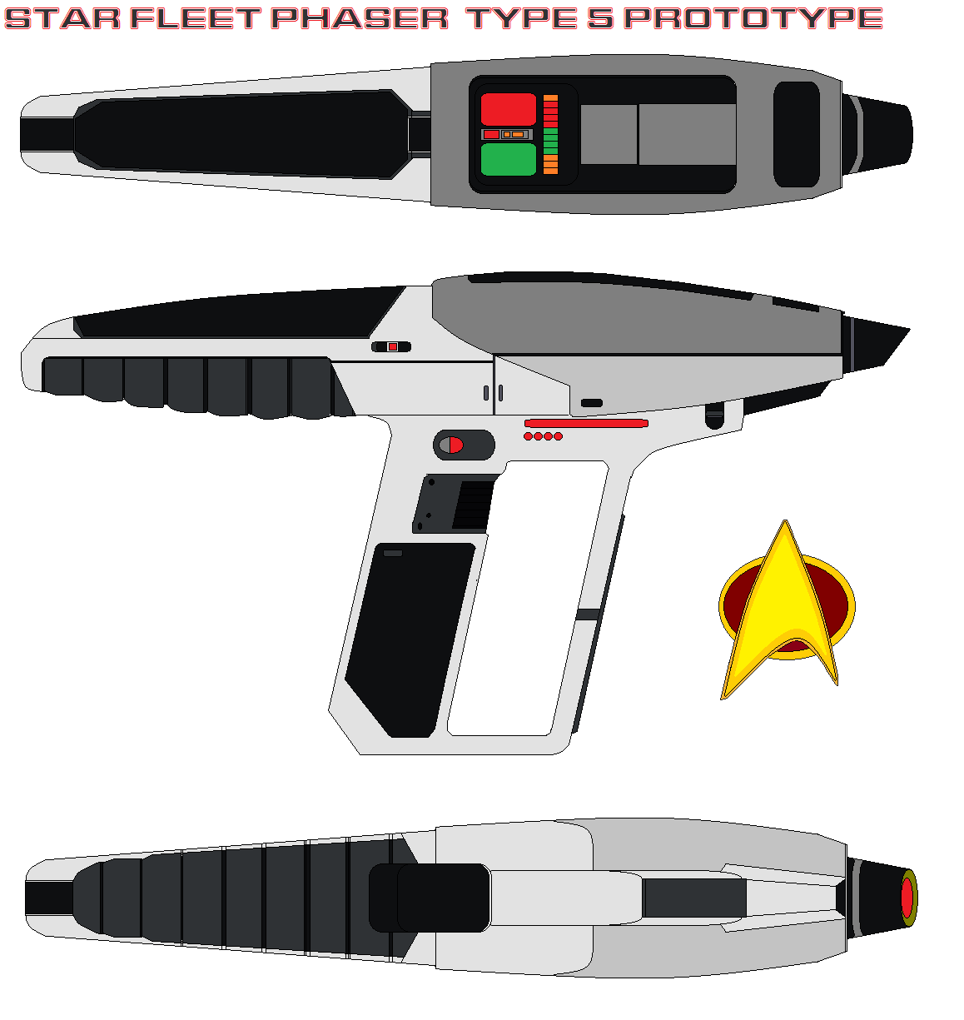
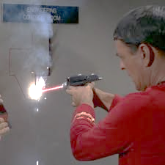
Show ideas and explain solutions
1. System Overview
What is the idea/solution?
What will it look like?
How will it work generally?
Image sources: http://bagera3005.deviantart.com/art/Star-fleet-phaser-type-5-prototype-621706391
http://www.projectrho.com/public_html/rocket/sidearmexotic.php

Slide 16
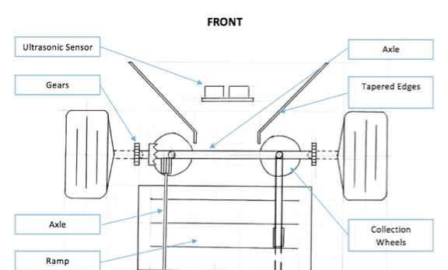
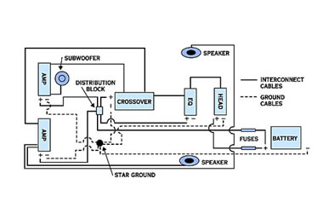
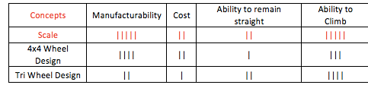
2. System / component details
Large components - Small components
Interaction of components
Why is this a good solution?
Evaluation
Analysis
Testing
Results
Conclusions

Slide 17
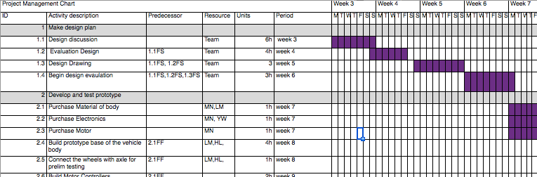
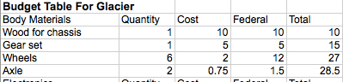
Work Plan
Tasks completed
Tasks to be completed
Team member roles
+ Why is this a good plan ?
Can you read this easily?

Slide 18
The Conclusion
Recap main points covered
Restate your position
Point out further implications.
Provide a stimulus for discussion
Thank the audience
“In conclusion, we have seen, through looking at… &…..”
“that the best solution is ….”
“Our next challenge is to design …”
“We’d like to hear your opinions on….”
“Thankyou for your attention & questions”

Slide 19
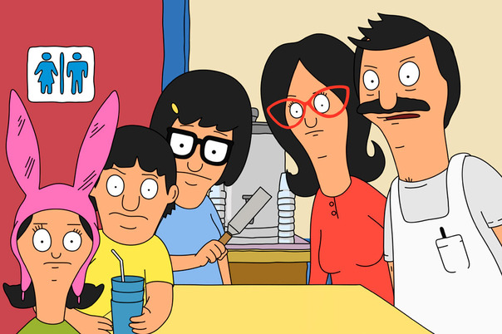
Question Time
So how do you respond?
As a general rule practice the following:
Listen carefully to the whole question.
Breathe naturally and stay relaxed so your thoughts remain focussed on the question.
Summarise or rephrase the question so the whole audience hears what has been asked.
Confirm your understanding of the question with a nod/eye contact and verbal check “The question was ... am I right ?”
Address the whole audience when you answer the question.
Conclude by asking if the answer was satisfactory/sufficient.
Audiences ask questions for a number of reasons.
They may:
misunderstand what you have said,
want further information,
present an alternative view or interpretation or procedure ,
want to raise other issues (these can be relevant or irrelevant).
TIP * Prepare possible questions and rehearse your answers

Slide 20
What makes a good speaker?
3MT 2014
Well prepared.
Has rehearsed many times
Passionate and confident
…?
…?
….?
+ View more good speakers at TED

Slide 21
Delivery
Body Language
Eye Contact
Voice
Handouts
Notes

Slide 22
Need more Info?
Fellow students
Your tutors/mentors
The Learning Centre- Online resources -http://www.lc.unsw.edu.au
The Learning Centre – Workshops & Consultations – online booking

Slide 23
Thankyou!
“It usually takes no more than three weeks to prepare a good impromptu speech”
(Mark Twain, nd.).

Slide 24
Projects
Check Moodle for specific information on the Design Proposal Report and Design Presentations for your project.

Slide 25
Mentor Session – Week 6
Peer Assessment Activity for the Conceptual Design Phase
Group Presentation
During Mentor Meeting in Week 6
See Guidelines on Moodle – Engineering Design Process section
Preparation
Review Team Problem Statement
Create a Morphological Chart – Functions and Attributes of the solution
Conduct a brain-storming session
Facilitation Guide on Moodle

Slide 26
Mentor Session – Week 6
Group Presentation – Mentor meeting Week 6
10 minutes plus 2 minutes question time
Concept Generation, Morph Chart, Methods, one aspect of design
Assessed by Mentor (50%) and other students (50%)
Individual Assessment
Submitted on Moodle by 9pm Friday, Week 6
One page description of a concept or sub-system you individually designed
Assessed by mentor

